Slide 1
LLM - Introduction
Large Language Models
Most figures taken from :
A Neural Probabilistic Language Model, Y. Bengio & al., 2000
Efficient Estimation of Word Representations in Vector Space, T. Mikolov & al., 2013

Slide 2
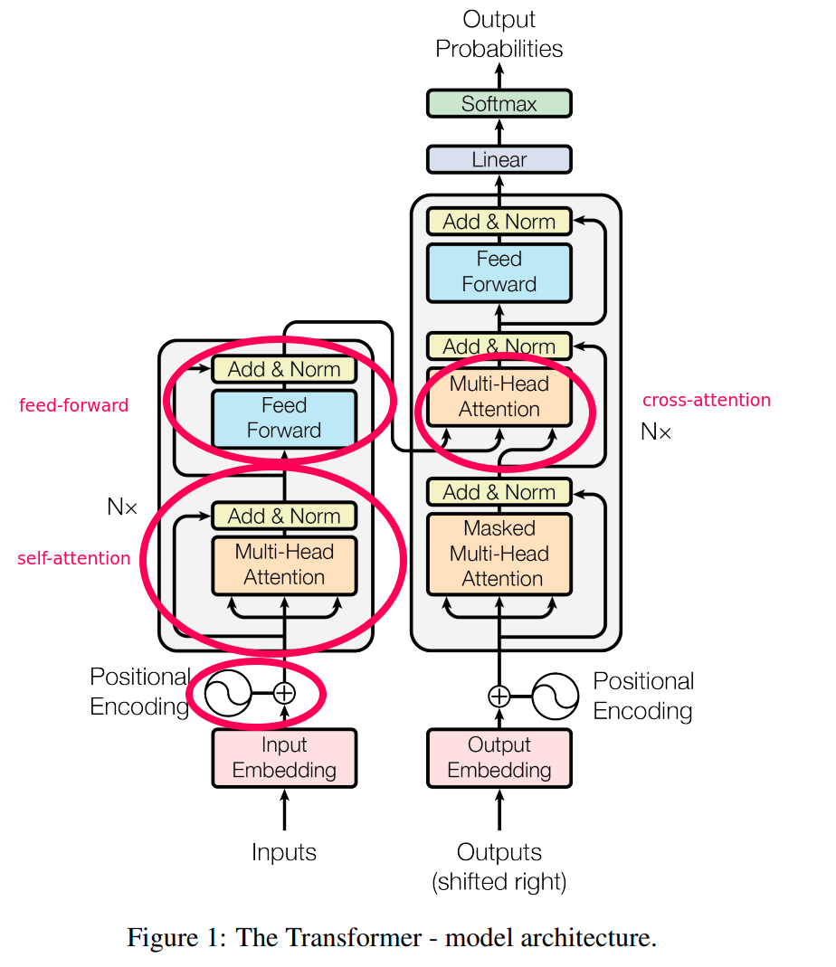
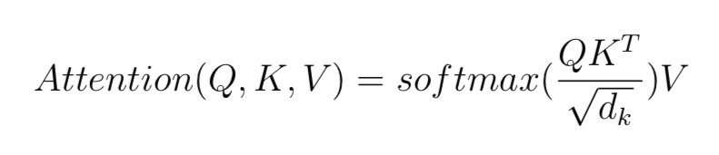
LLM - Attention

Slide 3
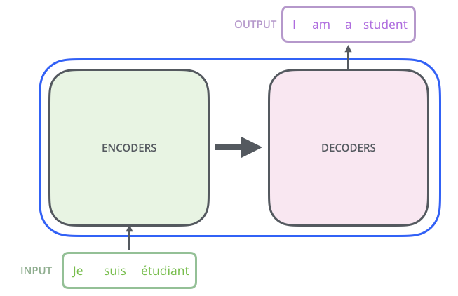
LLM - Transformers Architecture

Slide 4
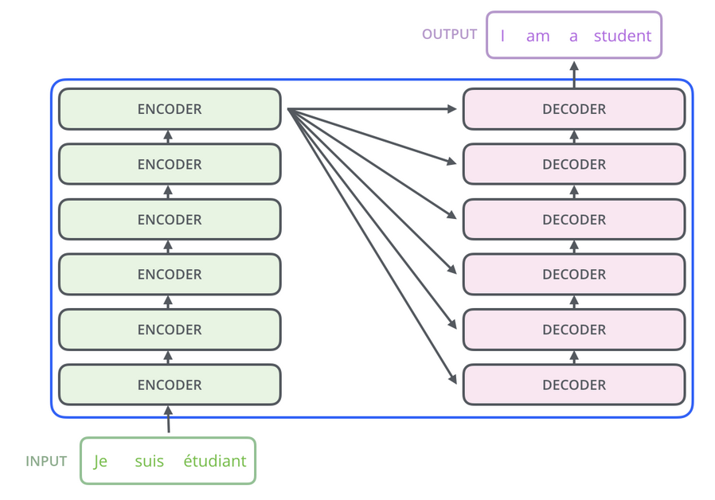
LLM - Transformers Architecture

Slide 5
LLM - Transformers Architecture
- Layers Stacking
- Same Structure
- Different Weights

Slide 6
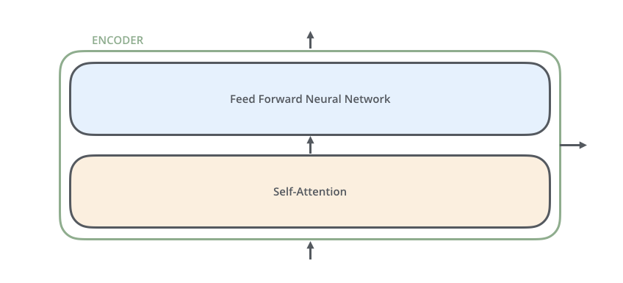
LLM - Encoder Architecture
- Self-Attention Layer
- Classical Feed-Forward Network

Slide 7
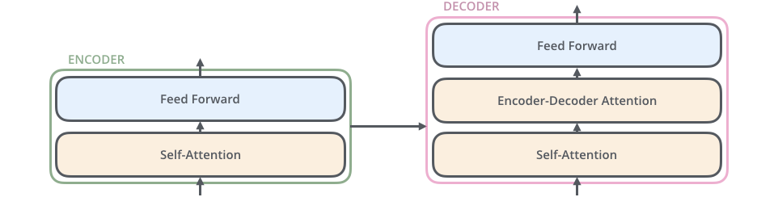
LLM – Encoder-Decoder Links
- Self-Attention Layer
- Cross-Attention Layer
- Classical Feed-Forward Network

Slide 8
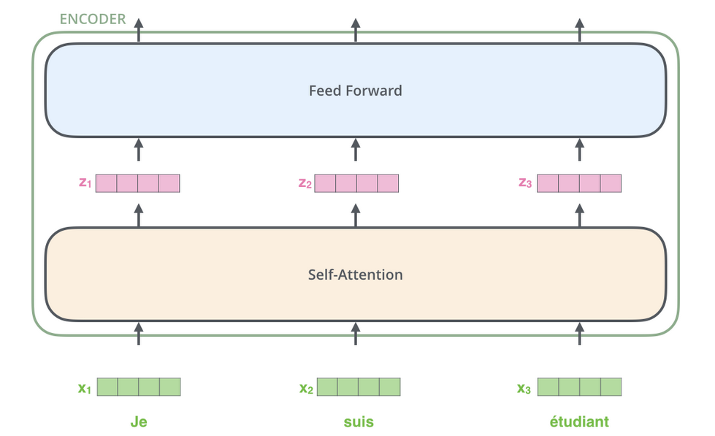
LLM - Decoder Architecture
- Input are embeddings
- Separate path for each token
- No dependencies in FFN

Slide 9
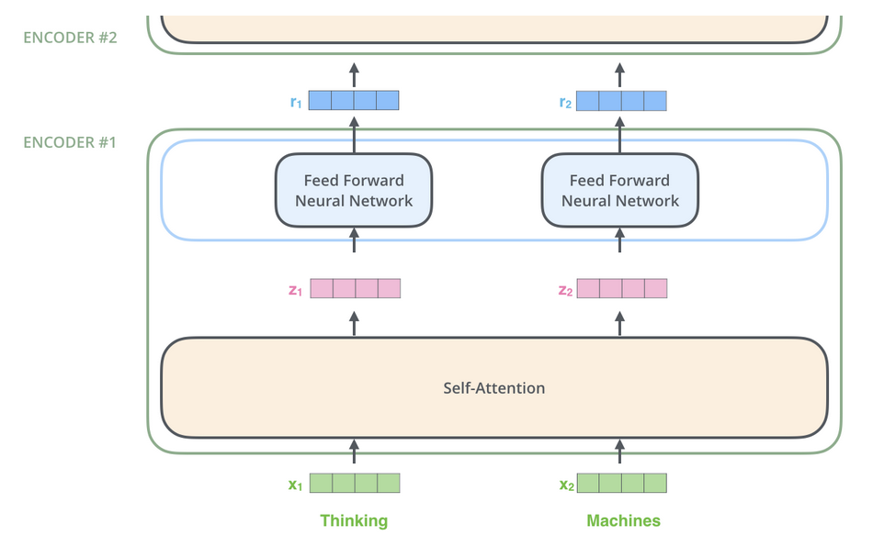
LLM – Encoding Process

Slide 10
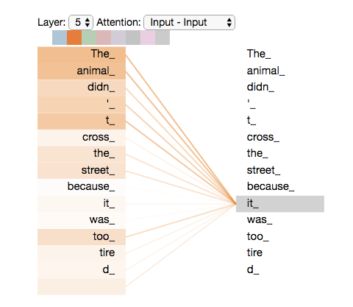
LLM – Why Attention
- Ambiguous relationships
- Long sentences

Slide 11
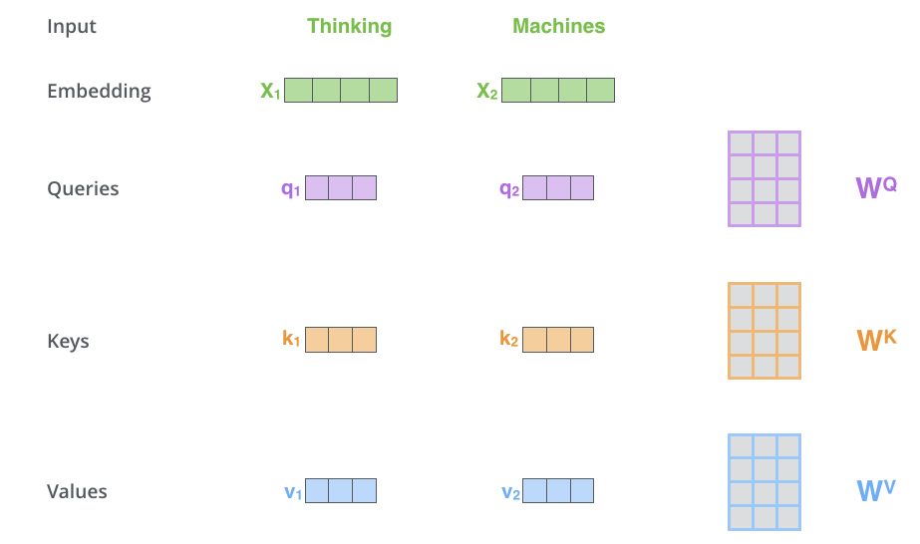
LLM – Self-Attention Mechanism
- Embedding Projection
- Computation costly

Slide 12
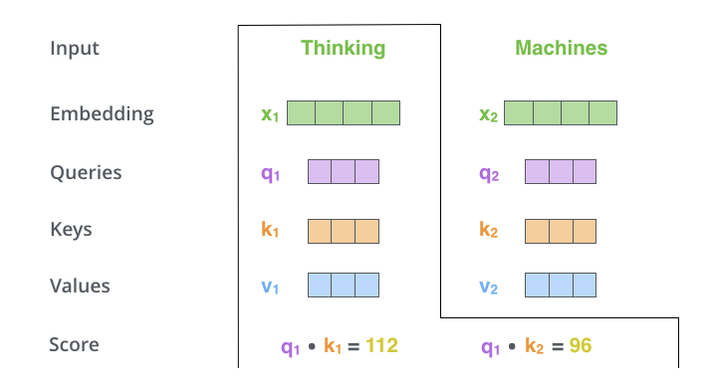
LLM – Self-Attention Mechanism
- Comparing each query to keys
- Similarity measure

Slide 13
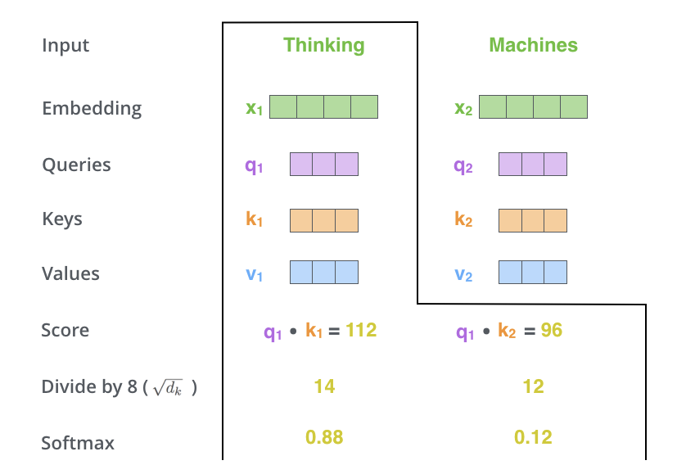
LLM – Self-Attention Mechanism
- Normalisation
- Softmax => probability distribution

Slide 14
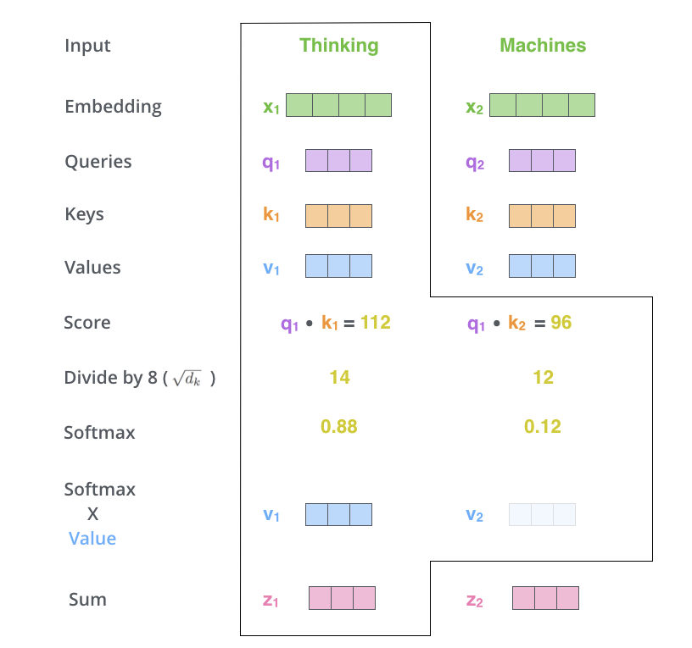
LLM – Self-Attention Mechanism
- Weighted output
- Sum of values

Slide 15
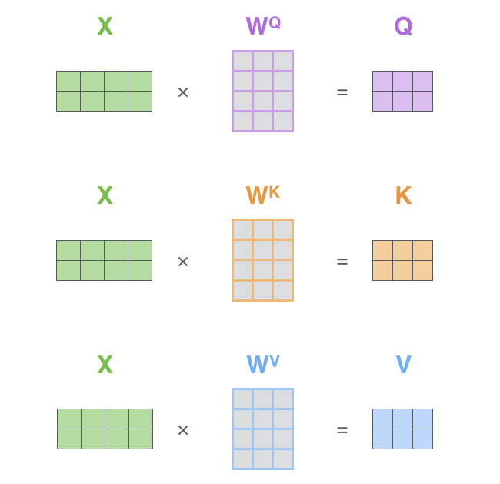
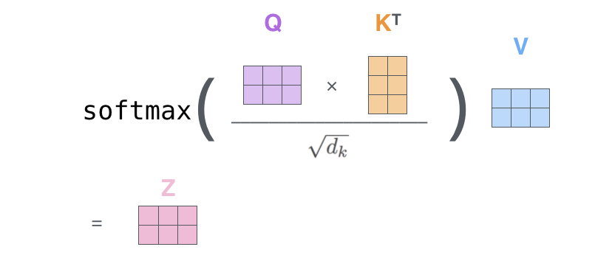
LLM – Self-Attention Mechanism
- Matrix operation
- Use of tensors

Slide 16
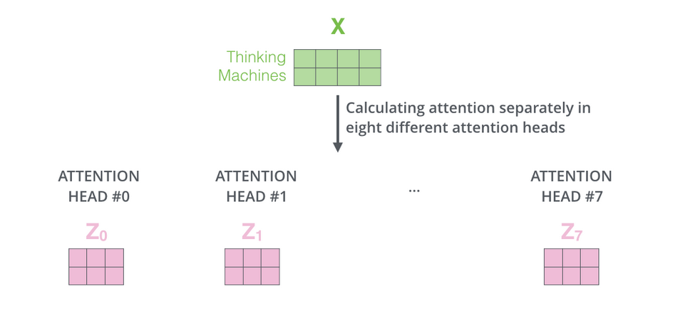
LLM – Multihead Self-Attention
- 8 heads
- Multiple subspaces
- Independent weights

Slide 17
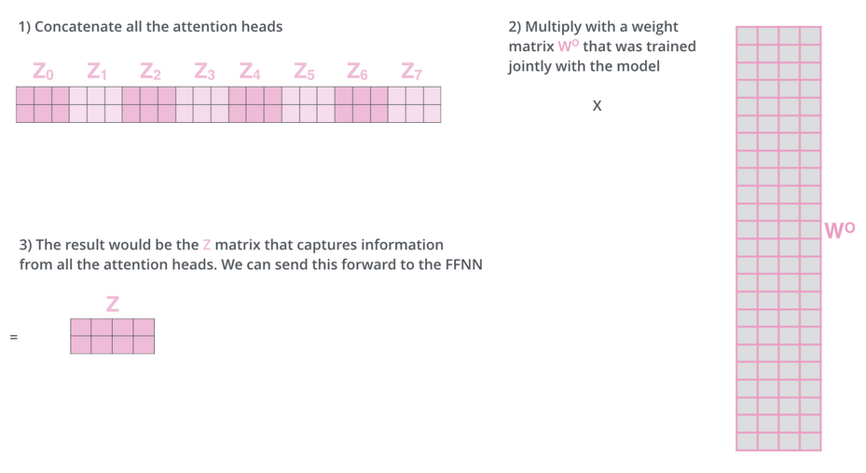
LLM – Multihead Self-Attention

Slide 18
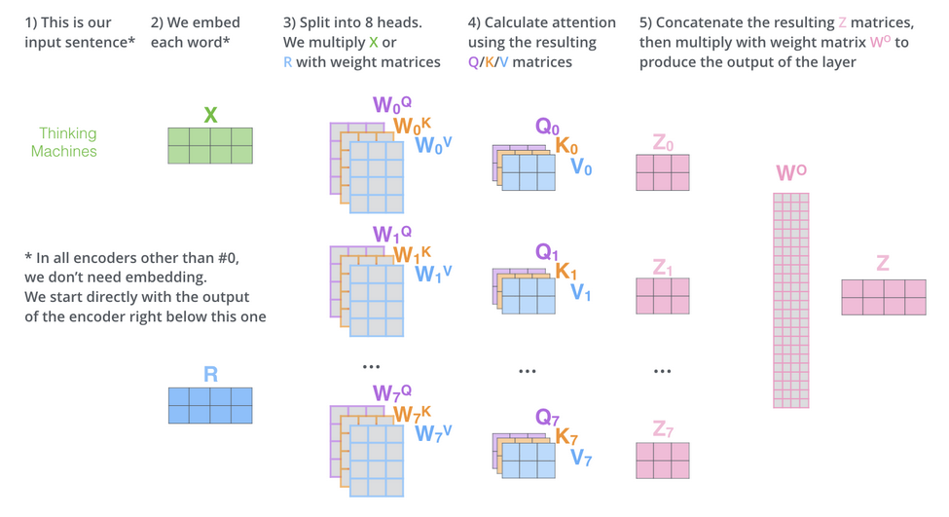
LLM – Multihead Self-Attention

Slide 19
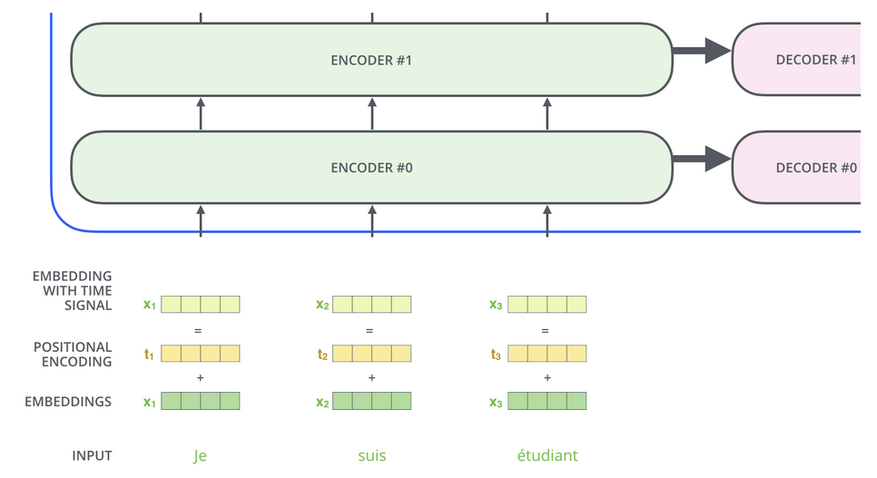
LLM – Positional Encoding
- Clues about time
- Fixed pattern

Slide 20
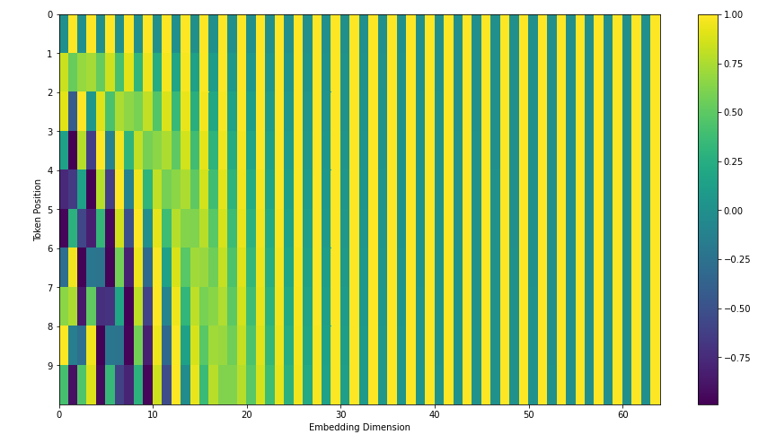
LLM – Positional Encoding
- Clues about time
- Fixed pattern

Slide 21
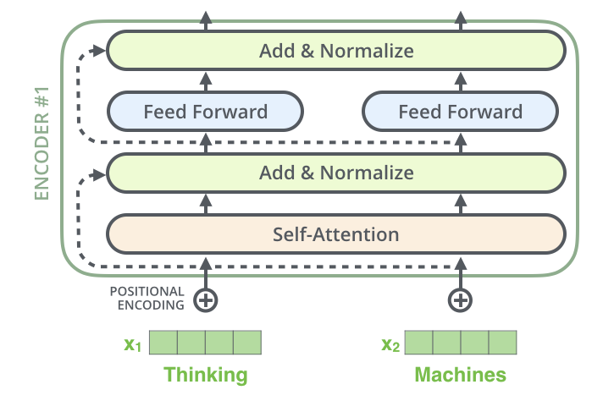
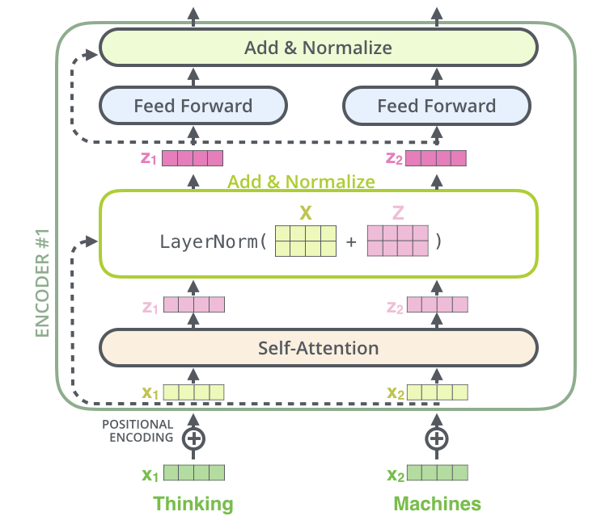
LLM – Layer Norm

Slide 22
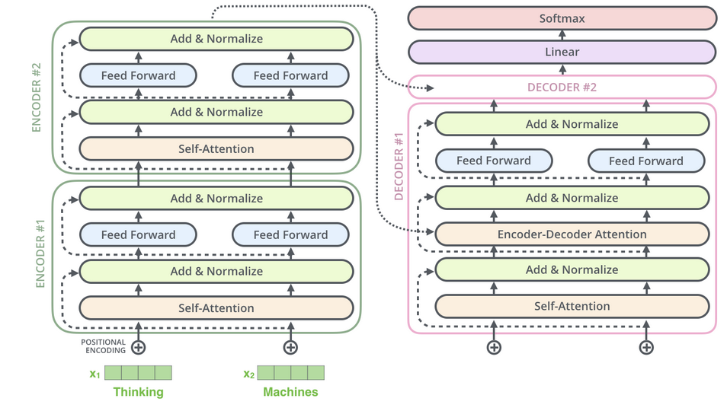
LLM – Decoder Attention
- Same Structure
- Cross-Attention
- K,V from Encoder

Slide 23
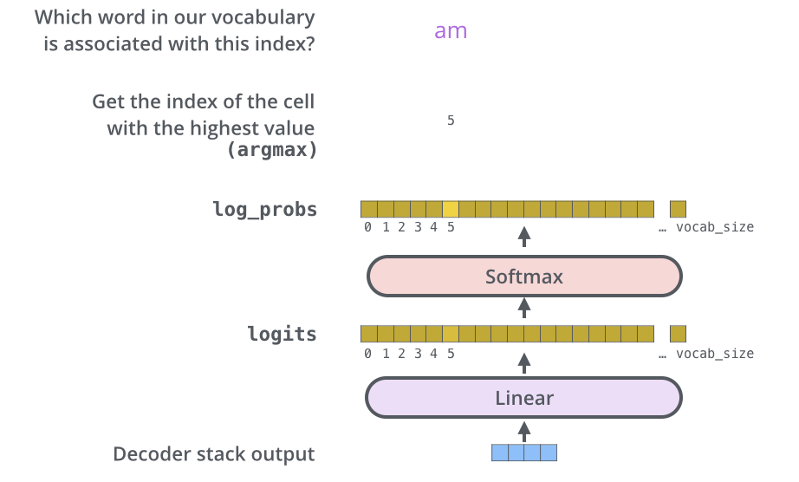
LLM – Head (Linear + Softmax)
- Probability over vocab size

Slide 24
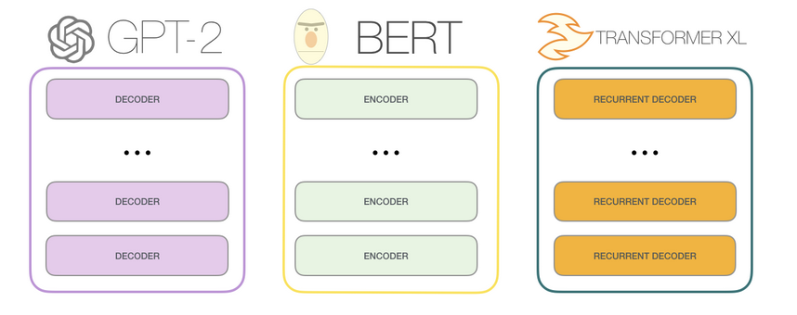
LLM – Model Examples

Slide 25
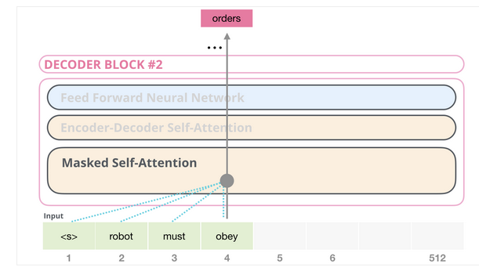
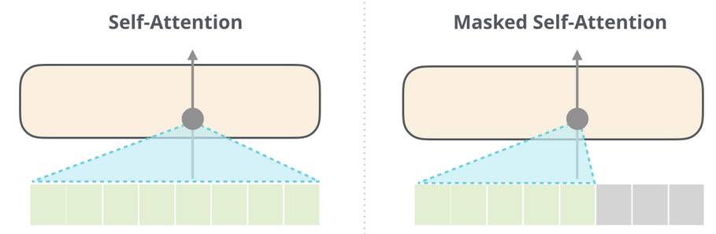
LLM – Masked Attention in GPT-2

Slide 26
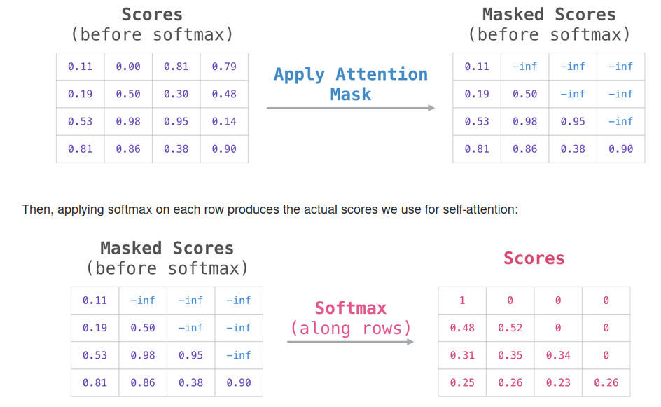
LLM – Masked Attention in GPT-2

Slide 27
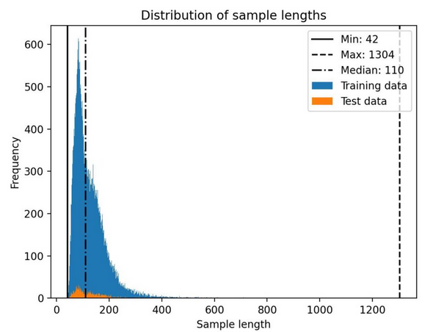
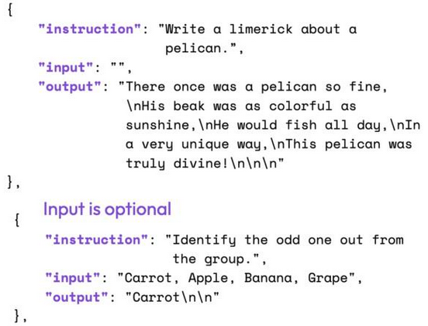
LLM – Instruction Dataset Alpaca
- Creating synthetic data from prompting ~50k tokens

Slide 28
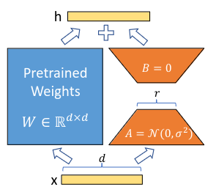
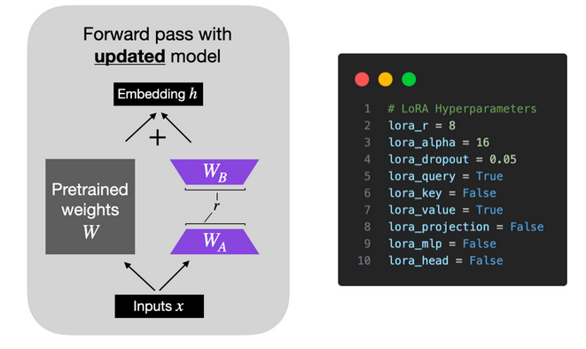
LLM – Fine-Tuning using LoRA

Slide 29
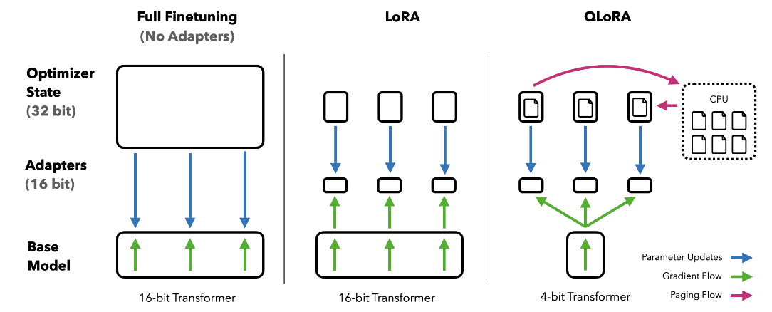
LLM – Fine-Tuning using QLoRA

Slide 30
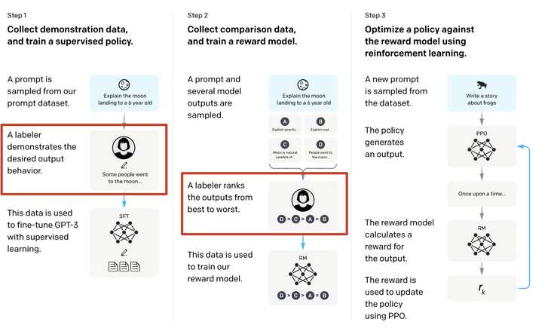
LLM – RL from Human Feedback

Slide 31
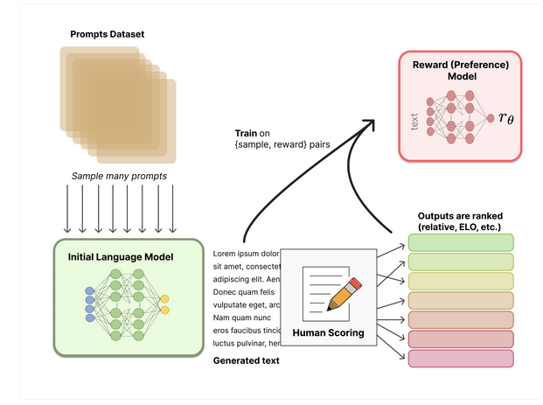
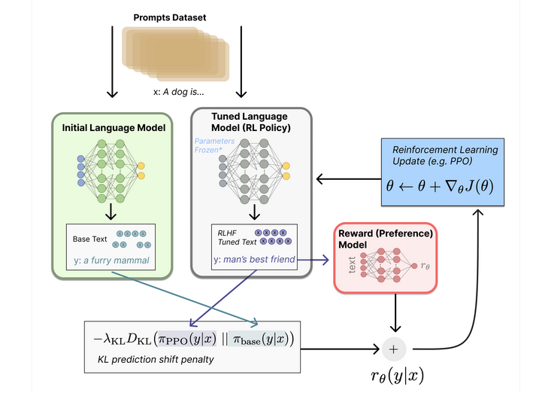
LLM – RL from Human Feedback

Slide 32
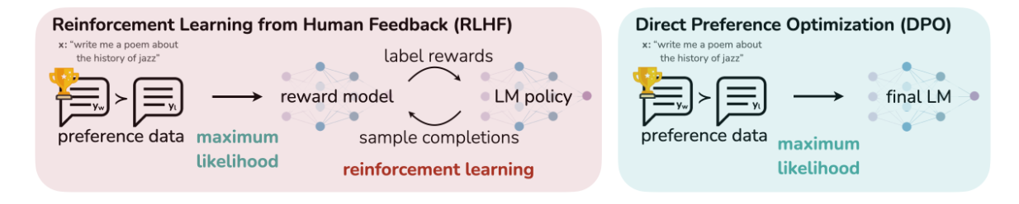
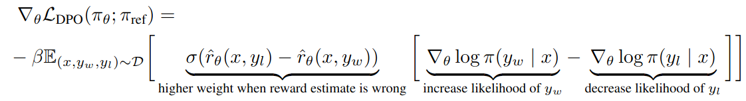
LLM – RLHF vs DPO
- Direct Preference Optimisation

Slide 33
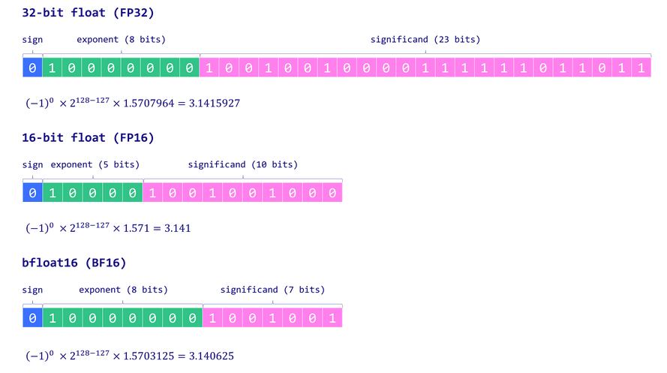
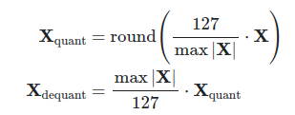
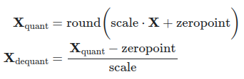
LLM – Quantisation

Slide 34
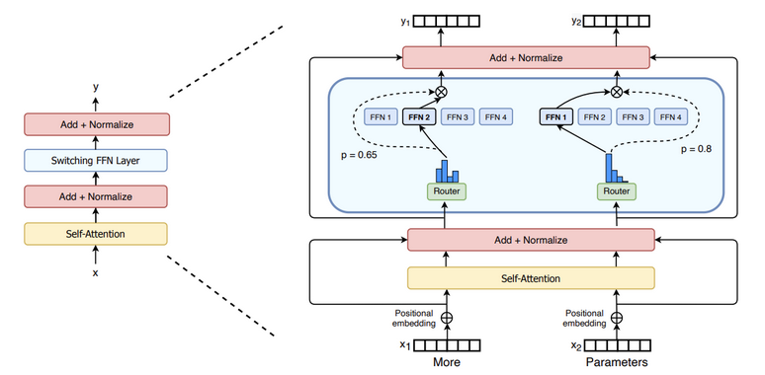
LLM – Mixture of Experts

Slide 35
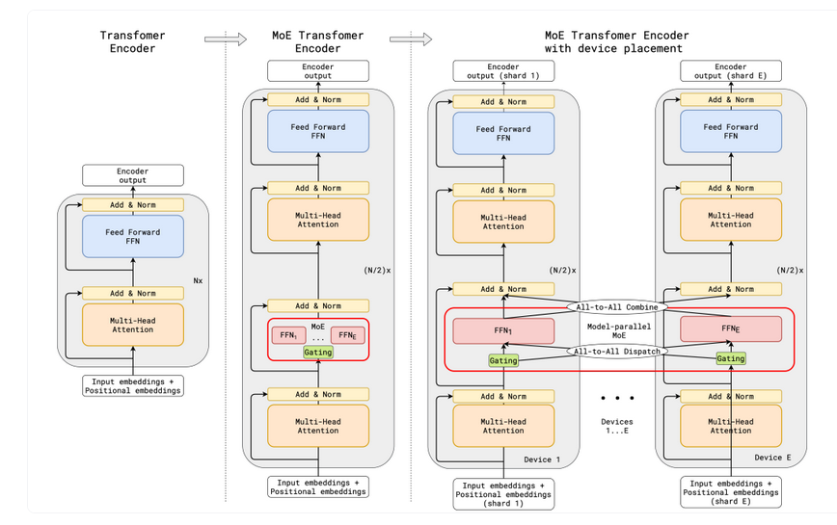
LLM – Mixture of Experts
- MoE adds diversity
- Cost reduction
- Conditional computation

